Slide 1
E-Library
Website
Teknologi Mikro Services / Web Service

Slide 2
Anggota Kelompok
Reza Zaini Fahmi 192310011
Muhamad Alkahfi 202310063
Eki virgiana 202310061

Slide 3
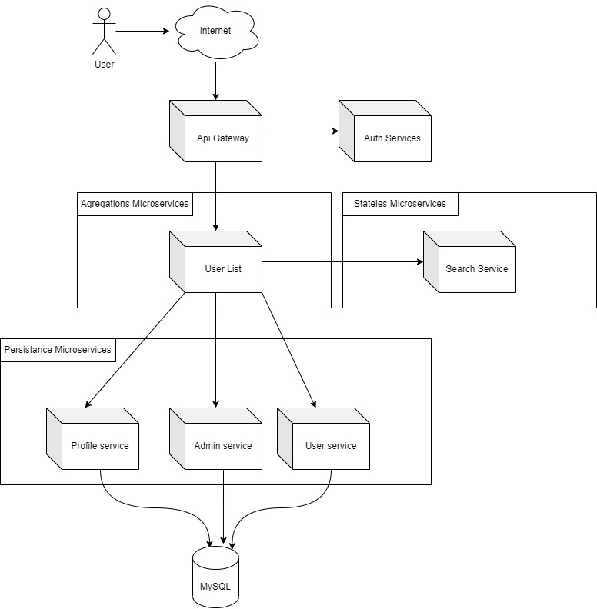
Architecture Services

Slide 4
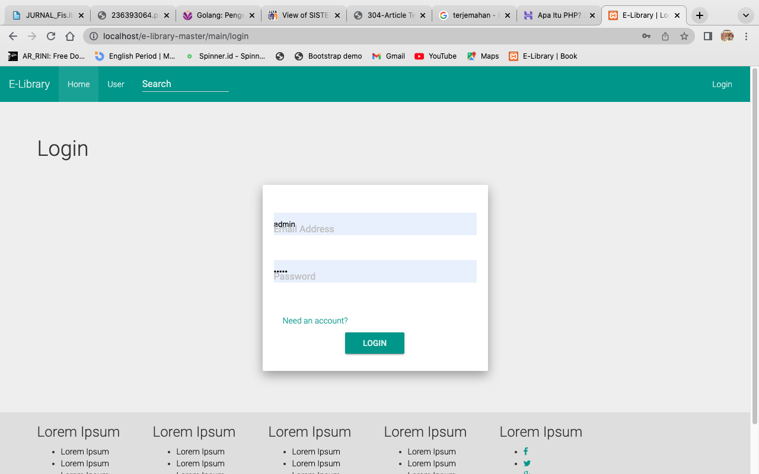
Website E - Library

Slide 5
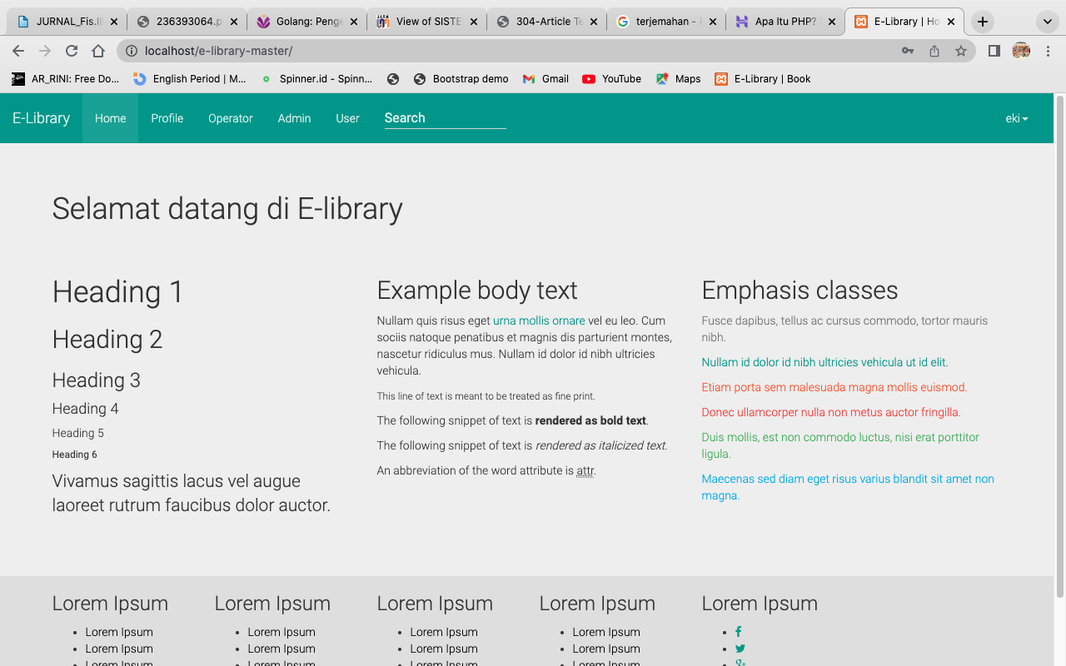
Website E - Library

Slide 6
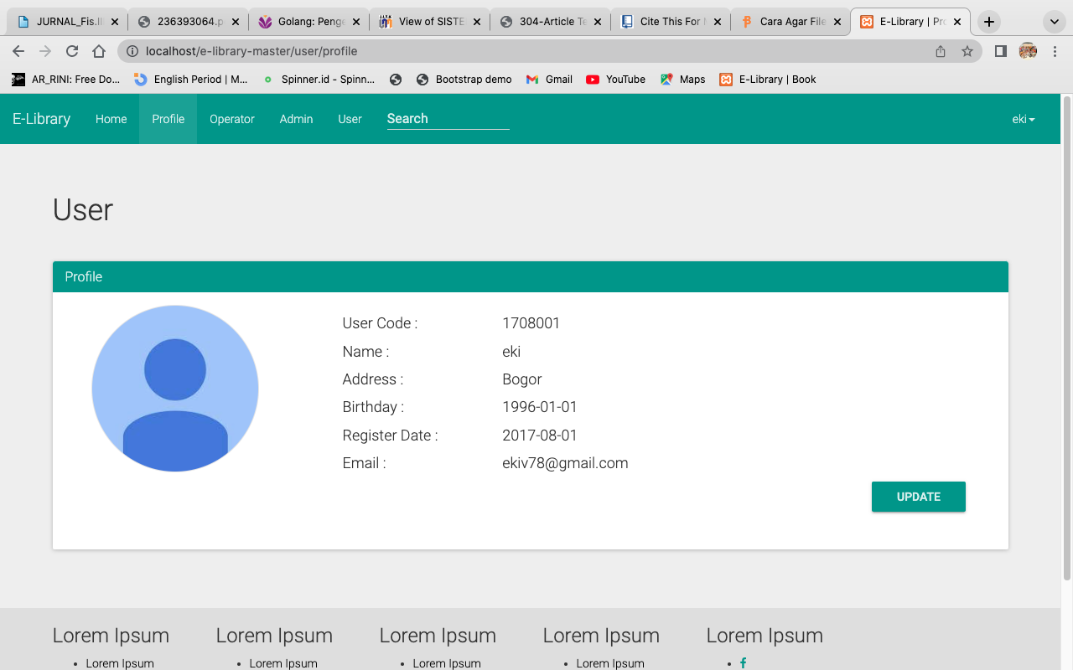
Website E - Library

Slide 7
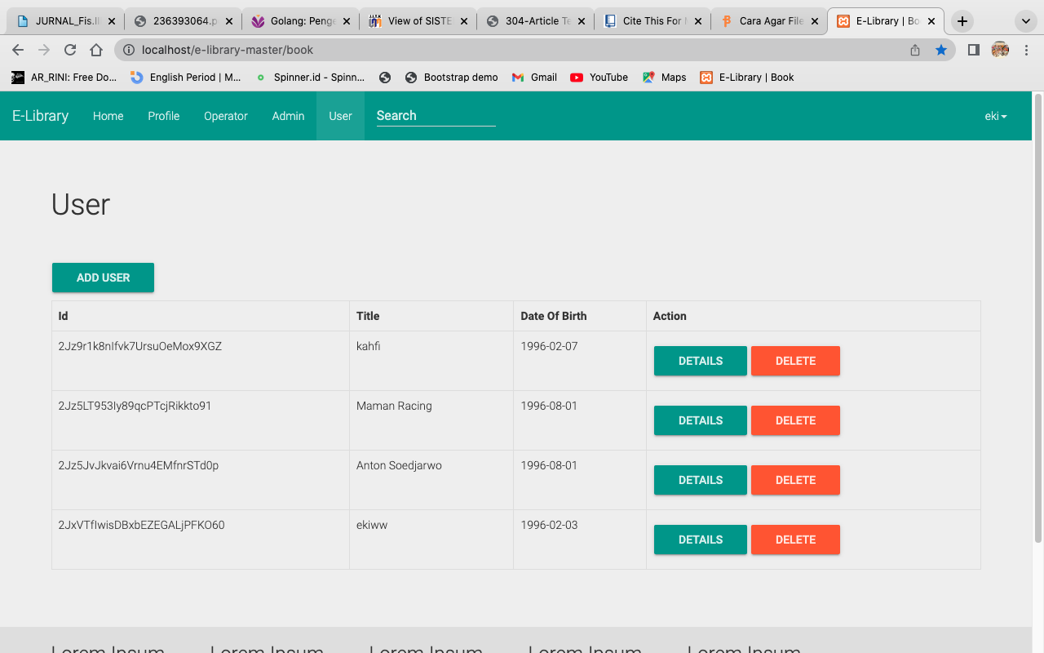
Website E - Library

Slide 8
THANK YOU
ANY QUESTIONS?

